Slide 1


Security on Blockchain Transaction
1
Presented By
Moulika Chadalavada
16234180
School of Computing and Engineering
University of Missouri-Kansas City, Missouri,64110

Slide 2
Agenda
2
Abstract
Introduction
Literature Review
Comparative Analysis
Findings of Analysis
Conclusion & Future Work
References

Slide 3
Abstract
3
Blockchain is distributed ledger
Orders and verifies transactions into blocks
No single centralized authority
Bitcoin first digital currency used Blockchain technology
Types of Blockchain – Permissioned and Permissionless
Blockchain validates transactions using consensus mechanisms
Consensus mechanisms allow secure updating of a distributed shared state
Using consensus transactions are encrypted and stored in blocks
Comparing different consensus algorithms means checking how each perform under a variety of attack scenarios

Slide 4
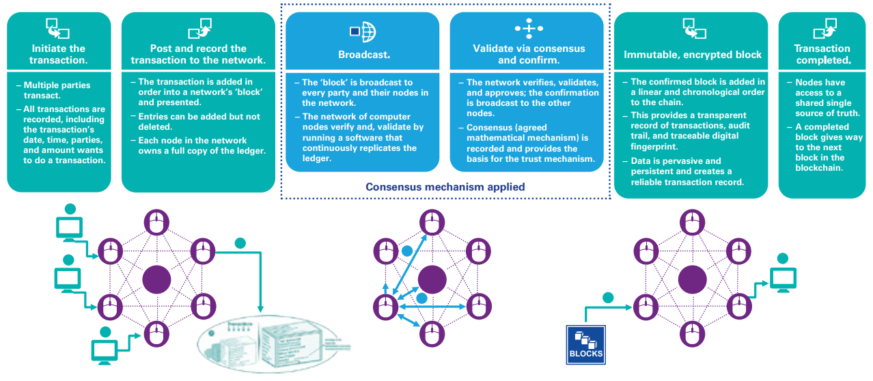
Introduction
4
Blockchain is distributed ledger database that maintains growing list of transaction records
Source: https://assets.kpmg.com/content/dam/kpmg/pdf/2016/06/kpmg-blockchain-consensus-mechanism.pdf

Slide 5

Introduction (contd..)
5
Consensus mechanism authenticates & validates every transaction on Blockchain.
Consensus mechanism central to functioning of Blockchain.
It is set of rules that maintains set of facts among participating nodes.
Consensus Algorithms allow connected machines to work as group.
Security is a multidimensional concept and is difficult to measure
All new algorithms are compared against Proof of Work.
Source: https://assets.kpmg.com/content/dam/kpmg/pdf/2016/06/kpmg-blockchain-consensus-mechanism.pdf

Slide 6
Literature Review
6
Proof-of-Work (1999)
Main goal is to deter cyber-attacks
Requirement to define an expensive computer calculation called mining
PoW is permissionless blockchain
Verify legitimacy of transactions
Creating digital currencies by rewarding miners
Reward miners who solve mathematical problem first
Used in Bitcoin mining, Hashcash
In 2009, PoW implemented as open-source code
Advantages: Feasible
Disadvantages: more computation work
vulnerable to 51% attack and selfish mining attack

Slide 7
Literature Review (contd..)
7
Proof-of-Stake (2012)
PoS requires fewer computations when compare to PoW
Replaces mining operation with an approach requires user ownership
Like PoW, it doesn't reward miners so they take transaction fees
Creator of new block selected in deterministic way
Randomly selects validators for block creation
More coins = More Mining Power
Ethereum uses PoS algorithm called Casper
Casper uses security deposits and bets to gain consensus
Advantages: Energy saving, Lower Latency
Disadvantages: Less Tested, More Centralization

Slide 8
Literature Review (contd..)
8
Byzantine Fault Tolerance (2013)
Hyperledger Fabric permissioned blockchain platform developed by Linux
Tolerates the class of failures known as the Byzantine General’s Problem
Pluggable consensus model
Main objective is to defend Byzantine failures
Participants identity is registered and verified with central registry
a. PBFT: Practical Byzantine Fault Tolerance
Provides high-performance Byzantine state machine replication
Process thousands of requests per second
Signing and encryption of messages
Messaging overhead increases as replicas increase

Slide 9
Literature Review (contd..)
9
b. SIEVE
Designed to handle non-determinism in chaincode execution
Non-determinism : produce different output when executed by different replicas
First executes all operations and then compare output across replicas
If divergence occurs among few replicas, those values are sieved out
c. Cross-Fault Tolerance (XFT)
Simplifies attack model and make BFT more feasible
Due to Adversary system BFT becomes more complex and becomes less efficient
XFT neglects adversary and solves state machine replication problem

Slide 10
Literature Review (contd..)
10
Federated Byzantine Agreement – Ripple & Stellar (2014)
Ripple
Ripple’s code based on bitcoin blockchain but not use Proof-of-Work
Ripple network uses Ripple consensus ledger
Node defines a Unique Node List (UNL)
Each participating server maintains its own UNL
Transactions takes place within seconds using UNL mechanism
Stellar
Uses concept of quorum and quorum slices
Quorum: set of nodes sufficient to reach agreement
Quorum Slices: Each node chooses which other nodes to trust
Quorum slices influence one another leading to quorums
Nodes sends confirmation messages to each other

Slide 11
Literature Review (contd..)
11
Delegated PoS (2014)
Combined characteristics of PoW and PoS
Reduce network centralization
Used first in BitShares application
Uses real-time voting system
Allowed to submit only one’s version of truth
Advantages: Transactions are fast, efficient, flexible
Disadvantages: If suffers from apathy of voters, like other systems
Convince other voters to obtain more than 50% of votes

Slide 12
Literature Review (contd..)
12
Tindermint (2015)
Deposit based consensus protocol
Leader selected based on chain rule called GHOST (Greedy Heaviest Observed Sub Tree)
GHOST either completely adopts or abandons block
Even if 1/3 of system fails Tindermint works efficiently
Tindermint’s 2 main components are Consensus Engine and Application Blockchain Interface
Consensus Engine: Checks if on every machine same transactions are registered
Application Blockchain Interface: Any kind of programming language transactions can be processed
Advantages: Simple understanding, ease-to-use
Disadvantages: Vulnerable to Nothing-at-Stake problem

Slide 13
Literature Review (contd..)
13
Proof of Elapsed Time (2016)
Intel Sawtooth Lake is a blockchain platform developed by Intel
Proof of Elapsed Time (PoET) consensus algorithm designed to achieve distributed consensus in efficient manner
Mainly focus on efficiency
PoET runs on trusted environment such as Intel’s Software Guard Extensions (SGX)
PoET uses lottery based election model
Cost for controlling this process should be proportional to value gained from it
The validator with the shortest wait time wins the lottery and can become the leader
Only drawback of this algorithm is the reliance on specialized hardware

Slide 14
Comparative Analysis
14
Comparative Analysis of Different Blockchain Security Consensus Mechanisms
# | Method | BT | SC | TM | TN | TR | AT | CP | TF | DC
1 | PoW [5] | Permissionless | High | Untrusted | Yes | Low | <=25% | Yes | Probabilistic | Yes
2 | PoS [7] | Permissioned | High | Untrusted | Yes | High | Based on algorithm used | Yes | Probabilistic | Yes
3 | PoET [9] | Both | High | Untrusted | No | Medium | Unknown | No | Probabilistic | Yes
4 | BFT and variants [10] | Permissioned | Low | Semi-trusted | No | High | <=33% | No | Immediate | No
5 | Federated BFT [13] | Permissionless | High | Semi-trusted | No | High | <=33% | No | Immediate | No
6 | DPoS [16] | Permissioned | High | Semi-trusted | Yes | Medium | <=33% | No | Probabilistic | Yes
7 | Tindermint [17] | Permissioned | High | Semi-trusted | Yes | High | <=33% | No | Probablistic | Yes
DPoS: Delegated Proof of Stake BFT: Byzantine Fault Tolerance PoW: Proof-of-Work PoS: Proof-of-Stake PoET: Proof-of-Elapsed Time BT: Blockchain Type SC: Scalability TM: Trust Model TN: Token Needed TR: Transaction Rate AT: Adversary Tolerance TF: Transaction Finality CP: Cost of Participation DC: Decentralized Control

Slide 15
Findings of Analysis
15
PoW and Federated BFT models are built exclusively for permissionless platforms with open-ended participation
PoW and PoET based consensus models carry the risk of multiple blocks being mined at the same time leads to Probablistic transaction
PoET may have high transaction rate because of its faster mechanism
Also BFT,PBFT has high transaction rates when compared to PoW
Design of PoW and PoS is based on existence of tokens
In PoW, PoS and PoET, nodes are untrusted as it is based on other factors computational work or security deposits
PoW, PoS, PoET are probabilistic as clients has to wait much longer for transaction confirmation
Based on platform the required consensus mechanism has to be selected

Slide 16
Conclusion & Future Work
16
Blockchain technology grown to great extent used in most of the applications maintaining security standards
Consensus models used by popular blockchain platforms
Permissionless platforms achieving robust consensus among very high number of untrusted peers
Permissioned blockchains are opting for a less scalable but much higher throughput model
Both functional and non-functional aspects has to be considered before determining the right platform and the right consensus model
PoS method is highly efficient for business related applications
If security is major concern then Federated BFT can be used

Slide 17
References
17
[1] Hiroki Watanabe, Shigeru Fujimura, Atsushi Nakadaira, "Blockchain contract: A complete consensus using blockchain", Consumer Electronics (GCCE) 2015 IEEE 4th Global Conference on, pp. 577-578, 2015.
[2] Shigeru Fujimura, Hiroki Watanabe, Atsushi Nakadaira, "BRIGHT: A concept for a decentralized rights management system based on blockchain", IEEE 5th International Conference on Data Analytics, pp. 345-346, 2015.
[3] K. Biswas and V. Muthukkumarasamy, "Securing Smart Cities Using Blockchain Technology," IEEE 14th International Conference on Smart City (HPCC/SmartCity/DSS), Sydney, NSW, 2016, pp. 1392-1393, 2016.
[4] K. Christidis M. Devetsikiotis "Blockchains and Smart Contracts for the IoTs" IEEE Access Special section on the plethora of Research in IoT pp. 2292-2303, 2016.
[5] S. Nakamoto, “Bitcoin: A Peer-to-Peer Electronic Cash System”, IEEE 2nd International Conference on Security, pp. 34-37, 2009.
[6] Nian, Lam Pak; Chuen, David LEE Kuo, "A Light Touch of Regulation for Virtual Currencies". In Chuen, David LEE Kuo. Handbook of Digital Currency: Bitcoin, Innovation, Financial,2015.

Slide 18
References
18
[7] M. Macdonald, L. Liu-Thorrold, R. Julien, “The Blockchain: A Comparison of Platforms and Their Uses Beyond Bitcoin”, IEEE Access Special section on Security, 2017.
[8] Tapscott, Don; Tapscott, Alex (May 2016). “The Blockchain Revolution, how the Technology Behind Bitcoin is Changing Money, Business, and the World”. ISBN 978-0-670-06997-2, 2016.
[9] R. Dennis and G. Owen, “Rep on the block: A next generation reputation system based on the blockchain” in the 10th International Conference for Internet Technology and Secured Transactions(ICITST-2015), pp. 131 –138,2015.
[10] S. Omohundro, “Cryptocurrencies, smart contracts, and artiﬁcial intelligence” in AI Matters, vol. 1, no. 2, pp. 19 –21,2014
[11] Jean-Pierre Buntinx, "Future Use Cases for Blockchain Technology: Copyright Registration", vol. 3, in Saint Bitts, 2016.
[12] Dinbits Staff, "The "Blockchain Technology" Bandwagon Has A Lesson Left To Learn", vol. 1, IN WEAS 04, 2016.

Slide 19
References
19
[13] Karl J. O'Dwyer , David Malone, “Bitcoin mining and its energy footprint”, Irish Signals & Systems Conference 2014 and 2014 China-Ireland International Conference on Information and Communications Technologies (ISSC 2014/CIICT 2014). 25th IET. 2014
[14] Peck, M., "Ethereum’s Blockchain-Powered Fund Opens Just as Researchers Call For Halt". IEEE Spectrum. Institute of Electrical and Electronics Engineers, 2016.
[15] Florian Tschorsch, Bjorn Scheuermann, "Bitcoin and Beyond: A Technical Survey on Decentralized Digital Currencies", Communications Surveys & Tutorials IEEE, vol. 18, pp. 2084-2123, 2016.
[16] Eduardo A. Alchieri, Alysson Neves Bessani, Joni Silva Fraga, and Fabola Greve, “Byzantine Consensus with Unknown Participants”, In Proceedings of the 12th International Conference on Principles of Distributed Systems. 22–40,2015
[17] A. Juels and J. Brainard, “Client puzzles: Cryptographic Countermeasure Against Connection Depletion Attacks.” in: Proceedings of NDSS ’99 (Networks and Distributed Systems Security), pp. 151–165, 2005.

Slide 20


